Slide 1
Assemblies in .NET

Slide 2
Objectives
Overview Assemblies in .NET
Explain components in .NET Assemblies: Manifest, Metadata, CIL and Resources
Explain Role of .NET Assemblies
Explain types .NET Assemblies : Static and Dynamic
Explain and demo about view CIL Code assemblies by ildasm tool
Explain demo about dumpbin tool
Demo create Assemblies and consume with C# Console Application

Slide 3
Assemblies Topics
What are the .NET Assemblies? Please describe the structure of .NET Assemblies
What is the role of the Assemblies in the application development?
How to secure the Assemblies in the applications? Please a demonstration about this
What is the difference between Static and Dynamic Assemblies?

Slide 4
What is the .NET Assemblies
Assemblies form the fundamental units of deployment, version control, reuse, activation scoping, and security permissions for .NET-based applications
An assembly is a collection of types and resources that are built to work together and form a logical unit of functionality
Assemblies take the form of executable (.exe) or dynamic link library (.dll) files, and are the building blocks of .NET applications. They provide the common language runtime with the information it needs to be aware of type implementations
In .NET (.NET 5), we can build an assembly from one or more source code files. This allows larger projects to be planned so that several developers can work on separate source code files or modules, which are combined to create a single assembly

Slide 5
Assemblies Properties
Assemblies are implemented as .exe (Windows OS) or .dll files
A .NET assembly can be static or dynamic and can be single-module or multimodule
Static assemblies are stored on disk in portable executable (PE) files. Static assemblies can include interfaces, classes, and resources like bitmaps, JPEG files, and other resource files
Dynamic assemblies are created dynamically at runtime and by using a specialized API of the .NET Core BCL called the Reflection Emit API, which is part of Reflection Services. A dynamic .NET assembly is created and executed directly in memory and it can be saved in a storage device

Slide 6
Assemblies Properties
Assemblies are only loaded into memory if they are required. If they aren't used, they aren't loaded. This means that assemblies can be an efficient way to manage resources in larger projects
We can programmatically obtain information about an assembly by using Reflection and load an assembly just to inspect it by using the MetadataLoadContext class and the Assembly.ReflectionOnlyLoad or Assembly.ReflectionOnlyLoadFrom methods

Slide 7
Role of .NET Assemblies
Assemblies Promote Code Reuse
A code library (a class library) is a *.dll that contains types intended to be used by external applications and allows us to reuse types in a language-independent manner
Assemblies Establish a Type Boundary
Every type's identity includes the name of the assembly in which it resides. A type called “MyType” that is loaded in the scope of one assembly is not the same as a type called “MyType” that is loaded in the scope of another assembly

Slide 8
Role of .NET Assemblies
Assemblies Are Versionable Units
Assemblies are assigned a four-part numerical version number of the form <major>.<minor>.<build>.<revision> that allows multiple versions of the same assembly to coexist in harmony on a single machine
All types and resources in the same assembly are versioned as a unit
Assemblies Are Self-Describing
Assemblies are regarded as self-describing, in part because they record in the assembly’s manifest every external assembly they must have access to in order to function correctly
In addition to manifest data, an assembly contains metadata that describes the composition (member names, implemented interfaces, base classes, constructors, etc ) of every contained type

Slide 9
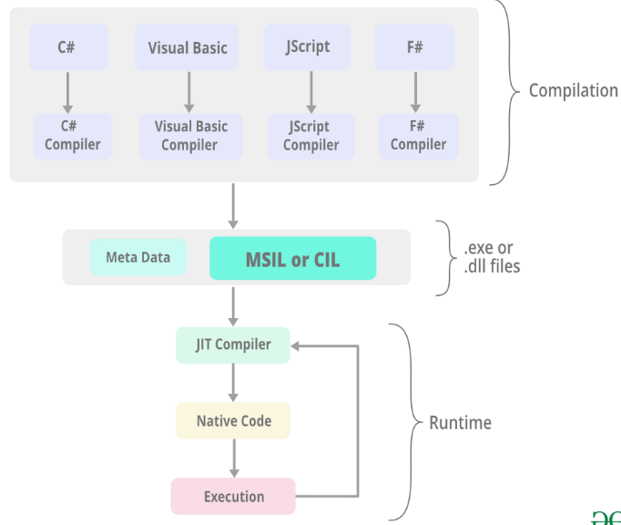
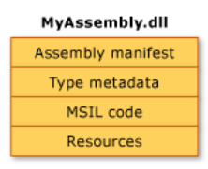
The Format of a .NET Assembly
A .NET assembly(*.dll or *.exe) consists of the following elements:
An operating system (e.g. Windows) file header
A CLR file header
An assembly manifest
Type metadata
CIL code
Optional embedded resources

Slide 10
The Format of a .NET Assembly
Type metadata: An assembly contains metadata that completely describes the format of the contained types, as well as the format of external types referenced by this assembly. The .NET Core runtime uses this metadata to resolve the location of types (and their members) within the binary, lay out(arrange) types in memory, and facilitate remote method invocations
CIL Code: At its core, an assembly contains CIL code that at runtime, the internal CIL is compiled on the fly using a just-in-time (JIT) compiler, according to the platform- and CPU-specific instructions
Optional embedded resources: contains any number of embedded resources, such as application icons, image files, sound clips, string tables or localized resources

Slide 11
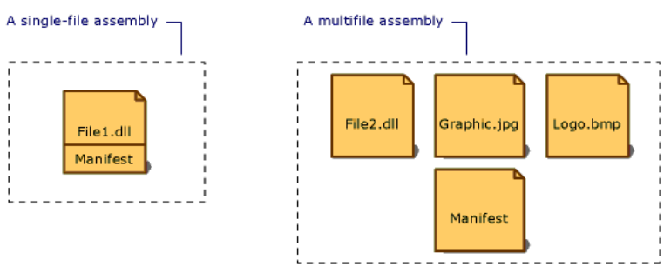
The Format of a .NET Assembly
An assembly manifest:
An assembly manifest contains all the metadata needed to specify the assembly's version requirements and security identity, and all metadata needed to define the scope of the assembly and resolve references to resources and classes
The assembly manifest can be stored in either a PE file (an .exe or .dll) with Microsoft intermediate language (MSIL) code or in a standalone PE file that contains only assembly manifest information

Slide 12
Create .NET Assemblies Demonstration

Slide 13
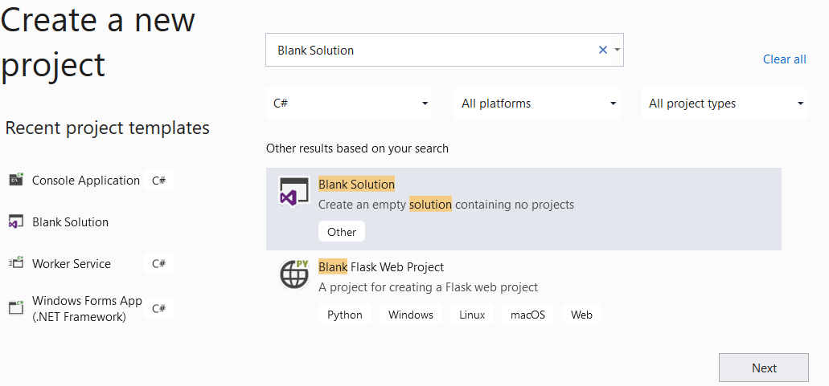
1. Create a Blank Solution to include all projects (Class Library and Console Application) by open the Visual Studio .NET application, choosing File | New Project | Blank Solution | Next
1
2
3

Slide 14
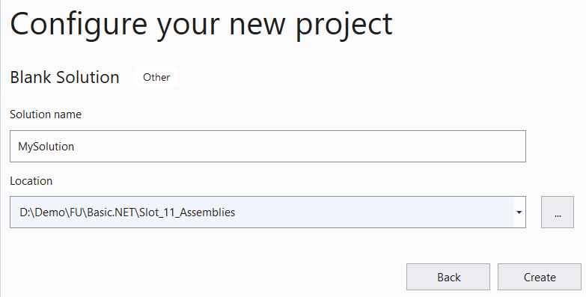
2. Fill out Solution name: MySolution and Location then click Next
4
5
6

Slide 15
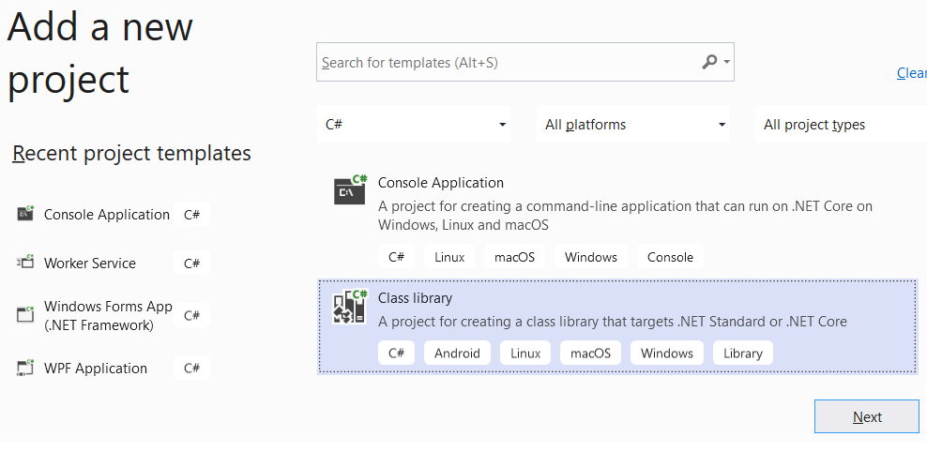
3. Add to the MySolution a Class Library project to create the assemblies
From the File menu | Add | New Project, on the Add New Project dialog, select “Class Library” then Next
1
2

Slide 16
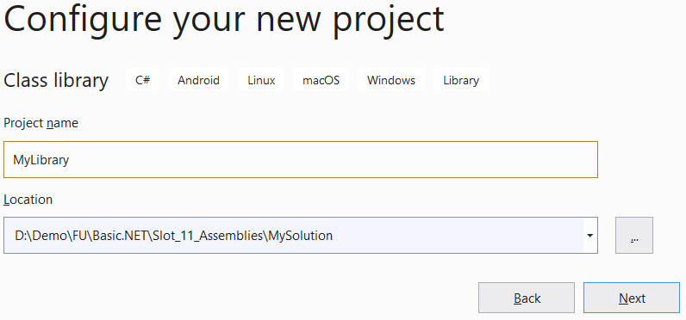
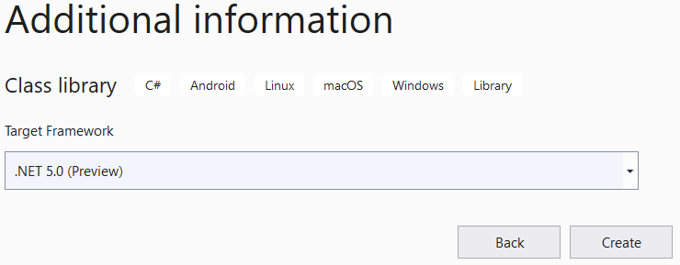
3
4
5
6
7

Slide 17
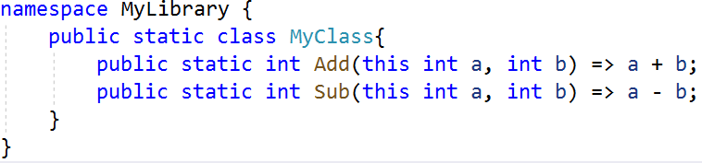
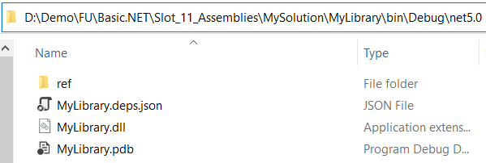
4. On the MyLibrary project, rename Class1.cs to MyClass.cs then write the
codes as follows :
5. Right-click on the MyLibrary project, select Build to compile to MyLibrary.dll

Slide 18
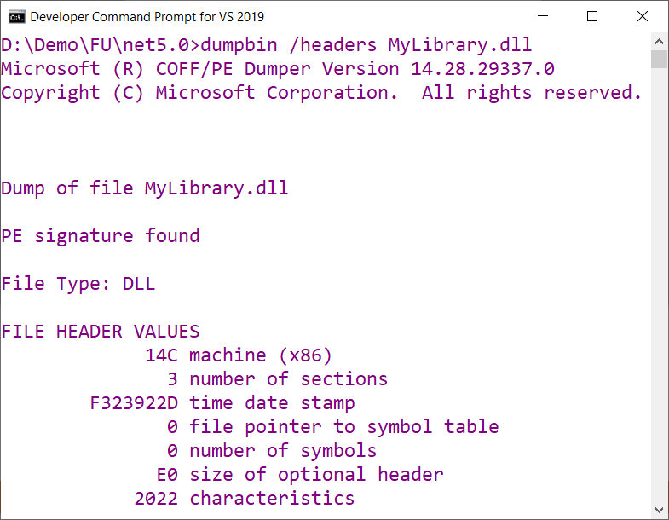
6. To view Operating system file header in the MyLibrary.dll
Open Developer Command Prompt for VS 2019, use dumpbin command
Notes:
Installing the C++ Profiling Tools on Visual Studio.NET Installer

Slide 19
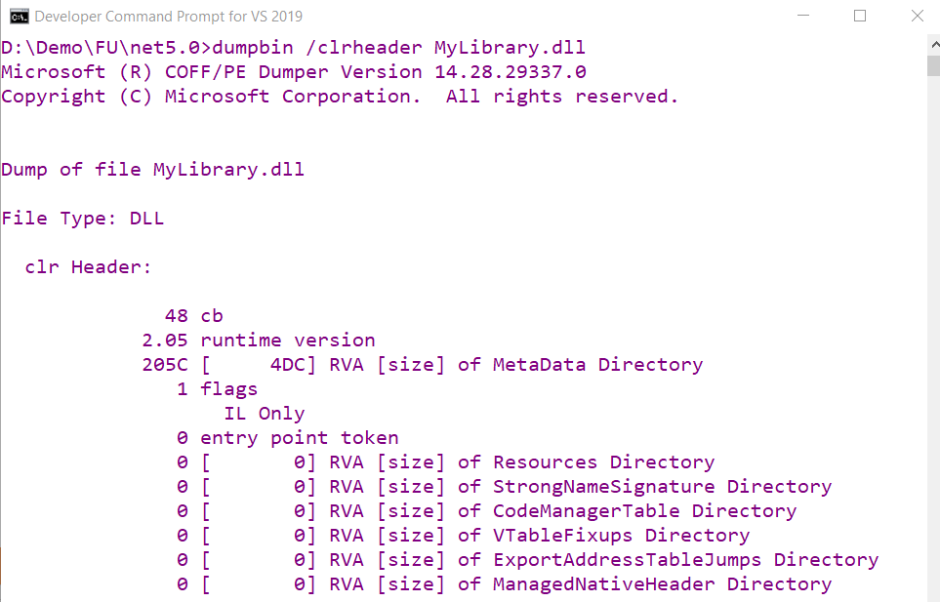
7. To view CLR file header in the MyLibrary.dll

Slide 20
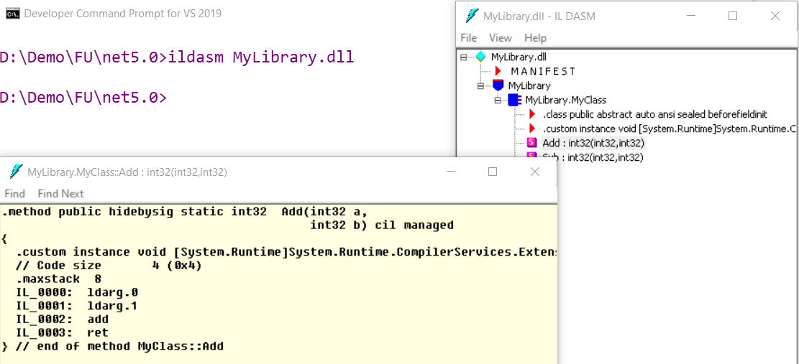
8. To view CIL Code in the MyLibrary.dll, use ildasm tool
double-click to view CIL
Notes:
To view MSIL of the assemblies :
1. Install ildasm tool : dotnet tool install -g dotnet-ildasm
2.View IL : dotnet ildasm Create_ConsoleApp_CLI.dll -o OutpuFileILCode.il

Slide 21
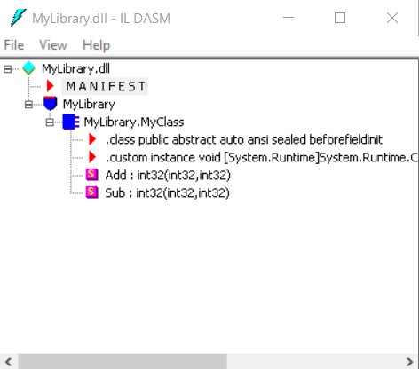
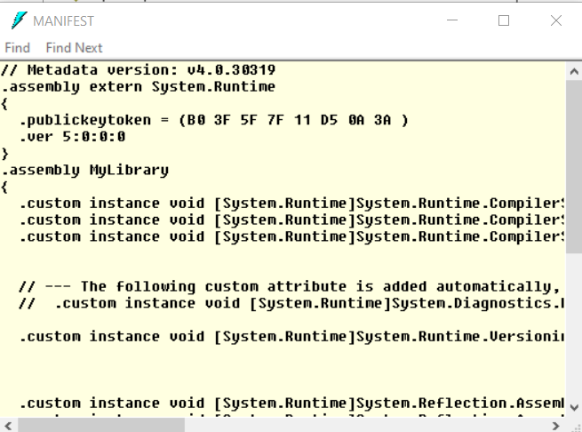
9. View MANIFEST in the MyLibrary.dll
double-click to view MANIFEST

Slide 22
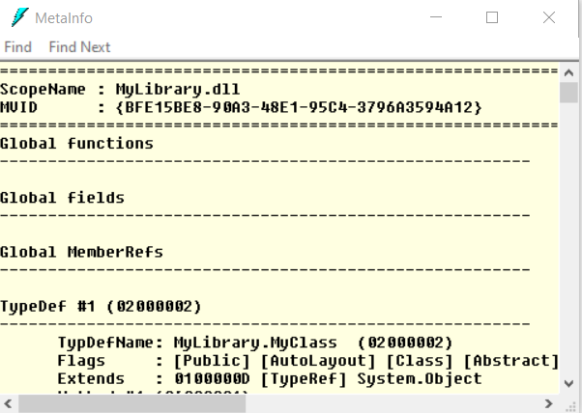
10. View Metadata in the MyLibrary.dll
Press Ctrl+M

Slide 23
Consuming Assemblies with C# Console Application Demonstration

Slide 24
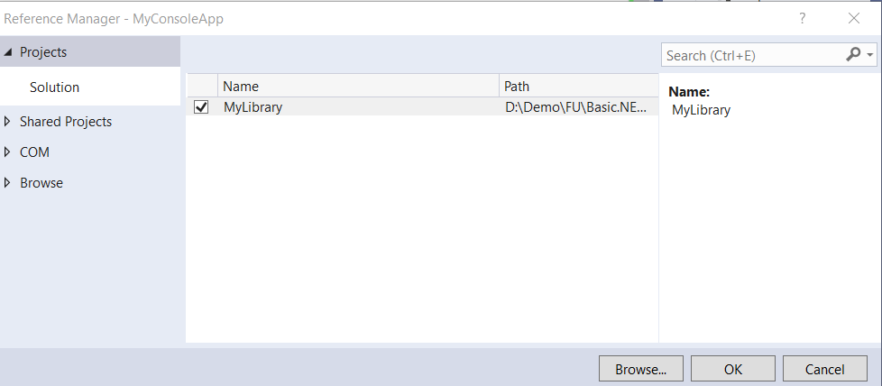
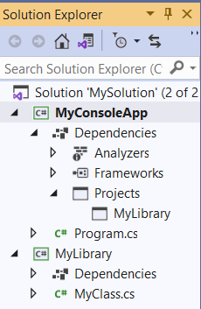
Add to MySolution a C# Console application named MyConsoleApp. After creating a MyConsoleApp project, right-click this project and select Set as Startup Project
Reference MyLibrary to the MyConsoleApp application
Right-click on the MyConsoleApp project, and choose Add | Project Reference | select MyLibrary on Reference Manager dialog as follows:
1
2

Slide 25
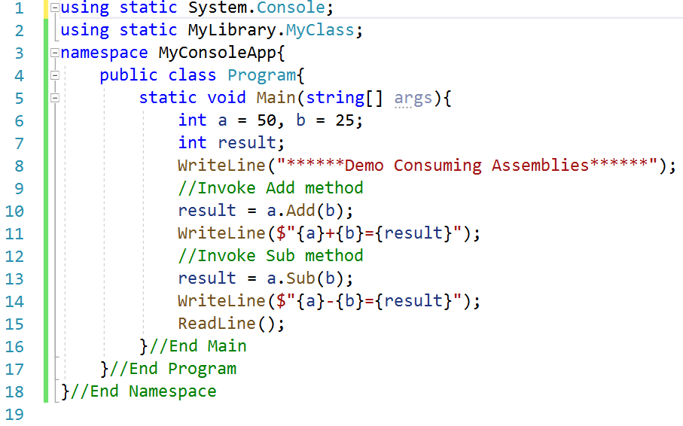
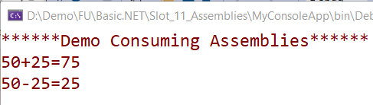
In the MyConsoleApp project , write the codes in Program.cs then Run

Slide 26
Summary
Concepts were introduced:
What is the Assemblies in .NET?
Explain components in .NET Assemblies: Manifest, Metadata, CIL and Resources
Explain Role of .NET Assemblies
Explain types .NET Assemblies : Static and Dynamic
Explain and demo about view CIL Code assemblies by ildasm tool
Explain demo about dumpbin tool
Demo create Assemblies and consume with C# Console Application

